Slide 1
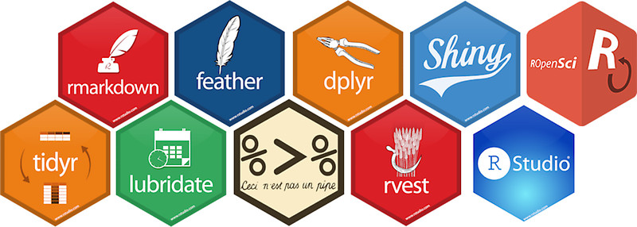
Using R as a Research Tool.
NERC E3 DTP Training – 7th November
Dr Susan Johnston, Institute of Evolutionary Biology
Demonstrators: Gergana Dalaskova, John Godlee

Slide 2

What is ?
Environment for statistical computing and graphics.
Interpreted programming language.
Powerful research tool.
Free and open source multi-platform software.

Slide 3
Why use ?
“This is R. There is no if. Only how.”
-- Simon `Yoda' Blomberg, R-help (April 2005)
Statistics.
Processing and tidying data.
Data visualisation.
Reports and presentations.
Interactive web applications.
Portable projects.

Slide 4
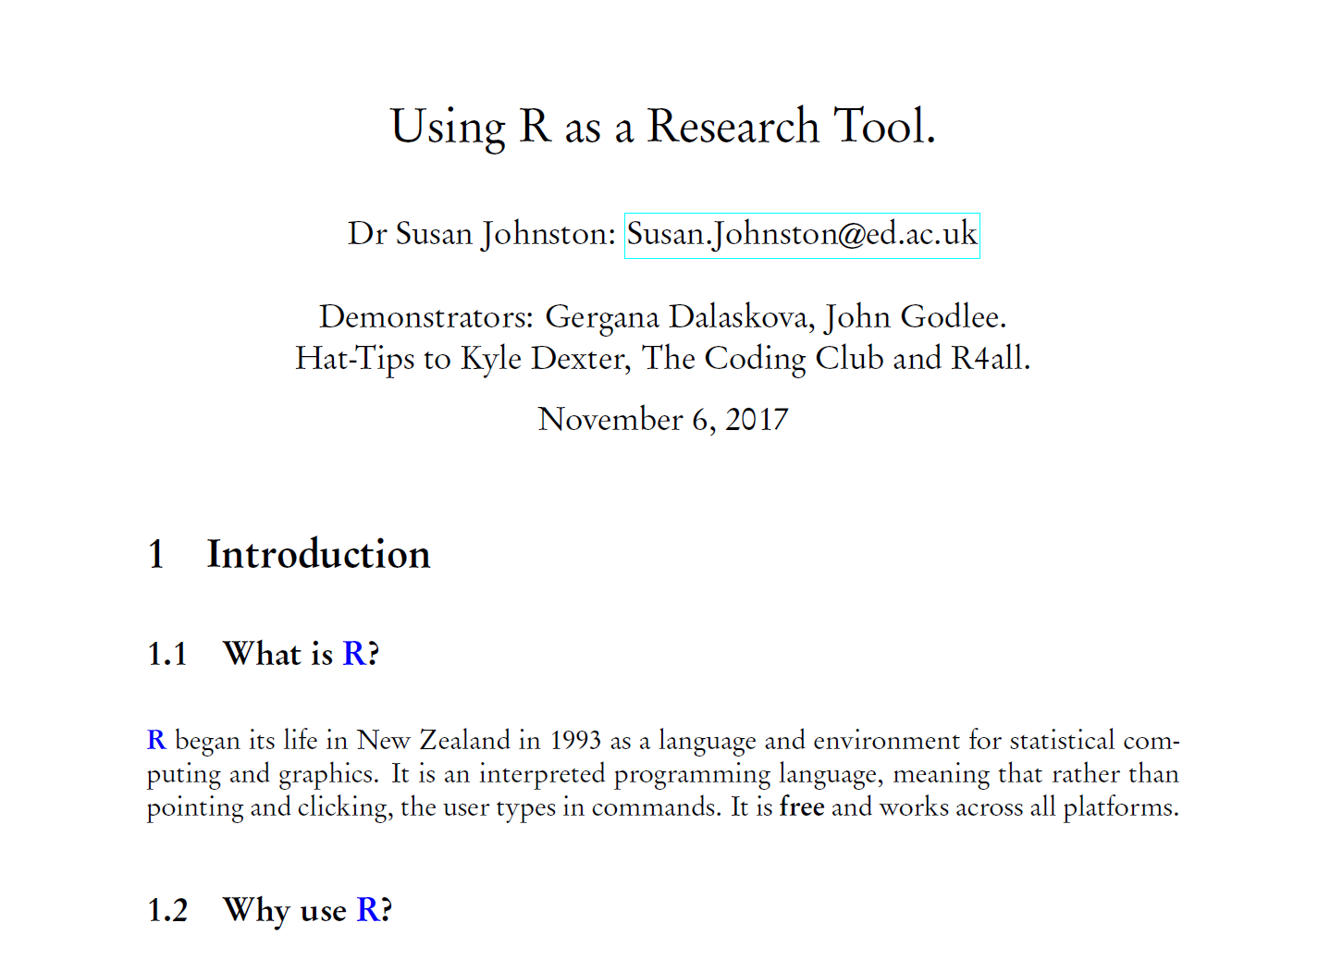
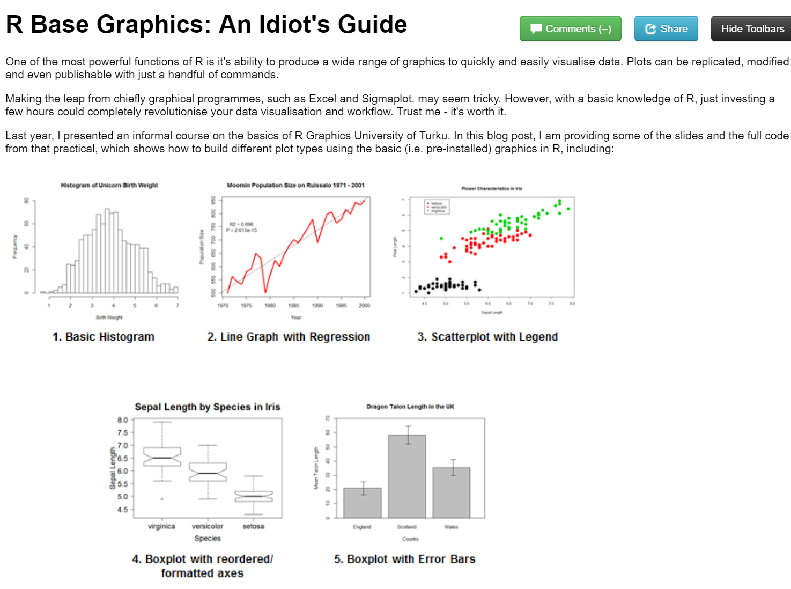
Report writing
LaTeX and R Sweave
knitr to HTML

Slide 5
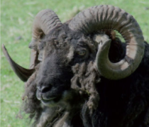
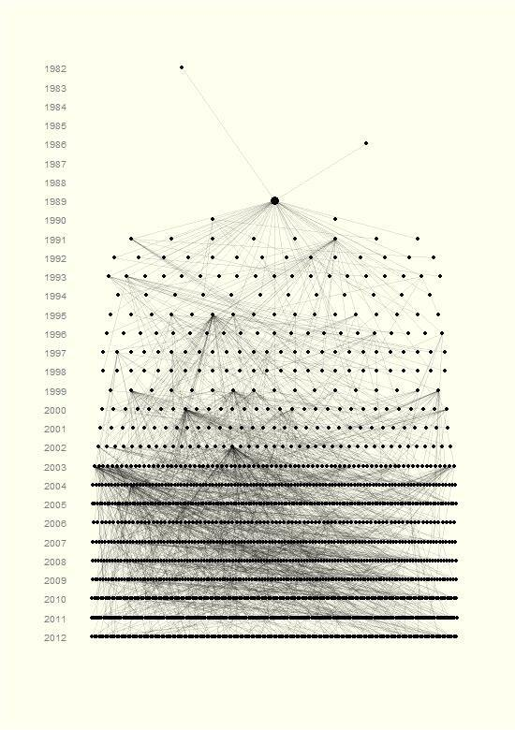
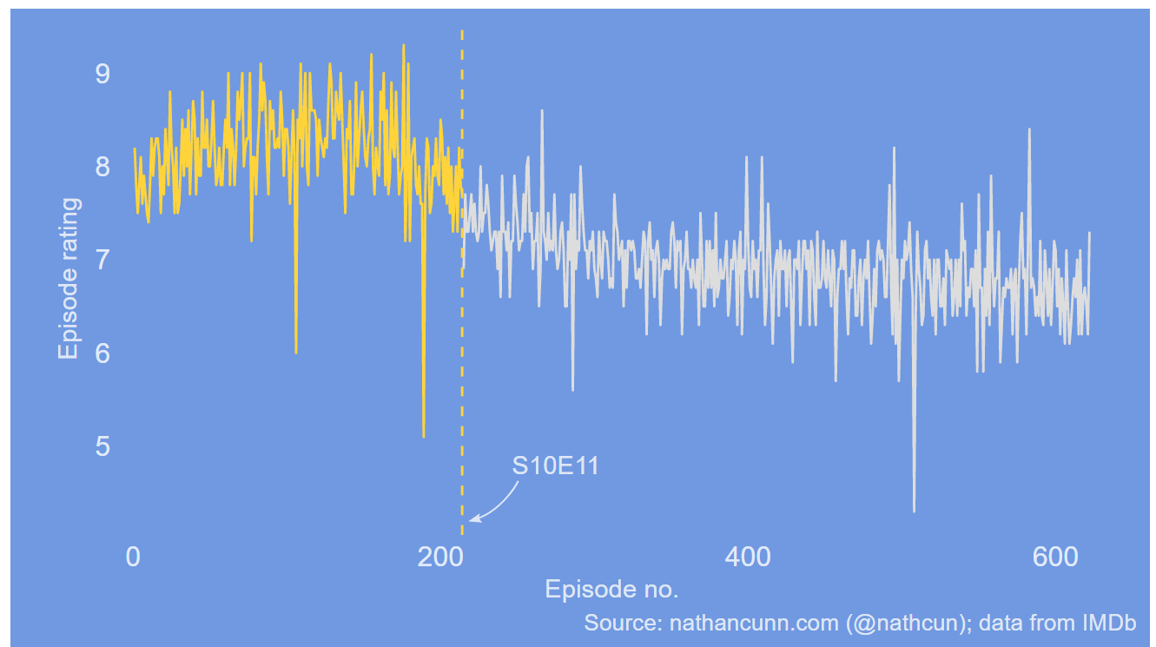
Data visualisation e.g. http://www.r-graph-gallery.com/portfolio/ggplot2-package/
When did the golden age of The Simpsons end?
Ancestors and descendants of a single Soay sheep called Snowball.

Slide 6
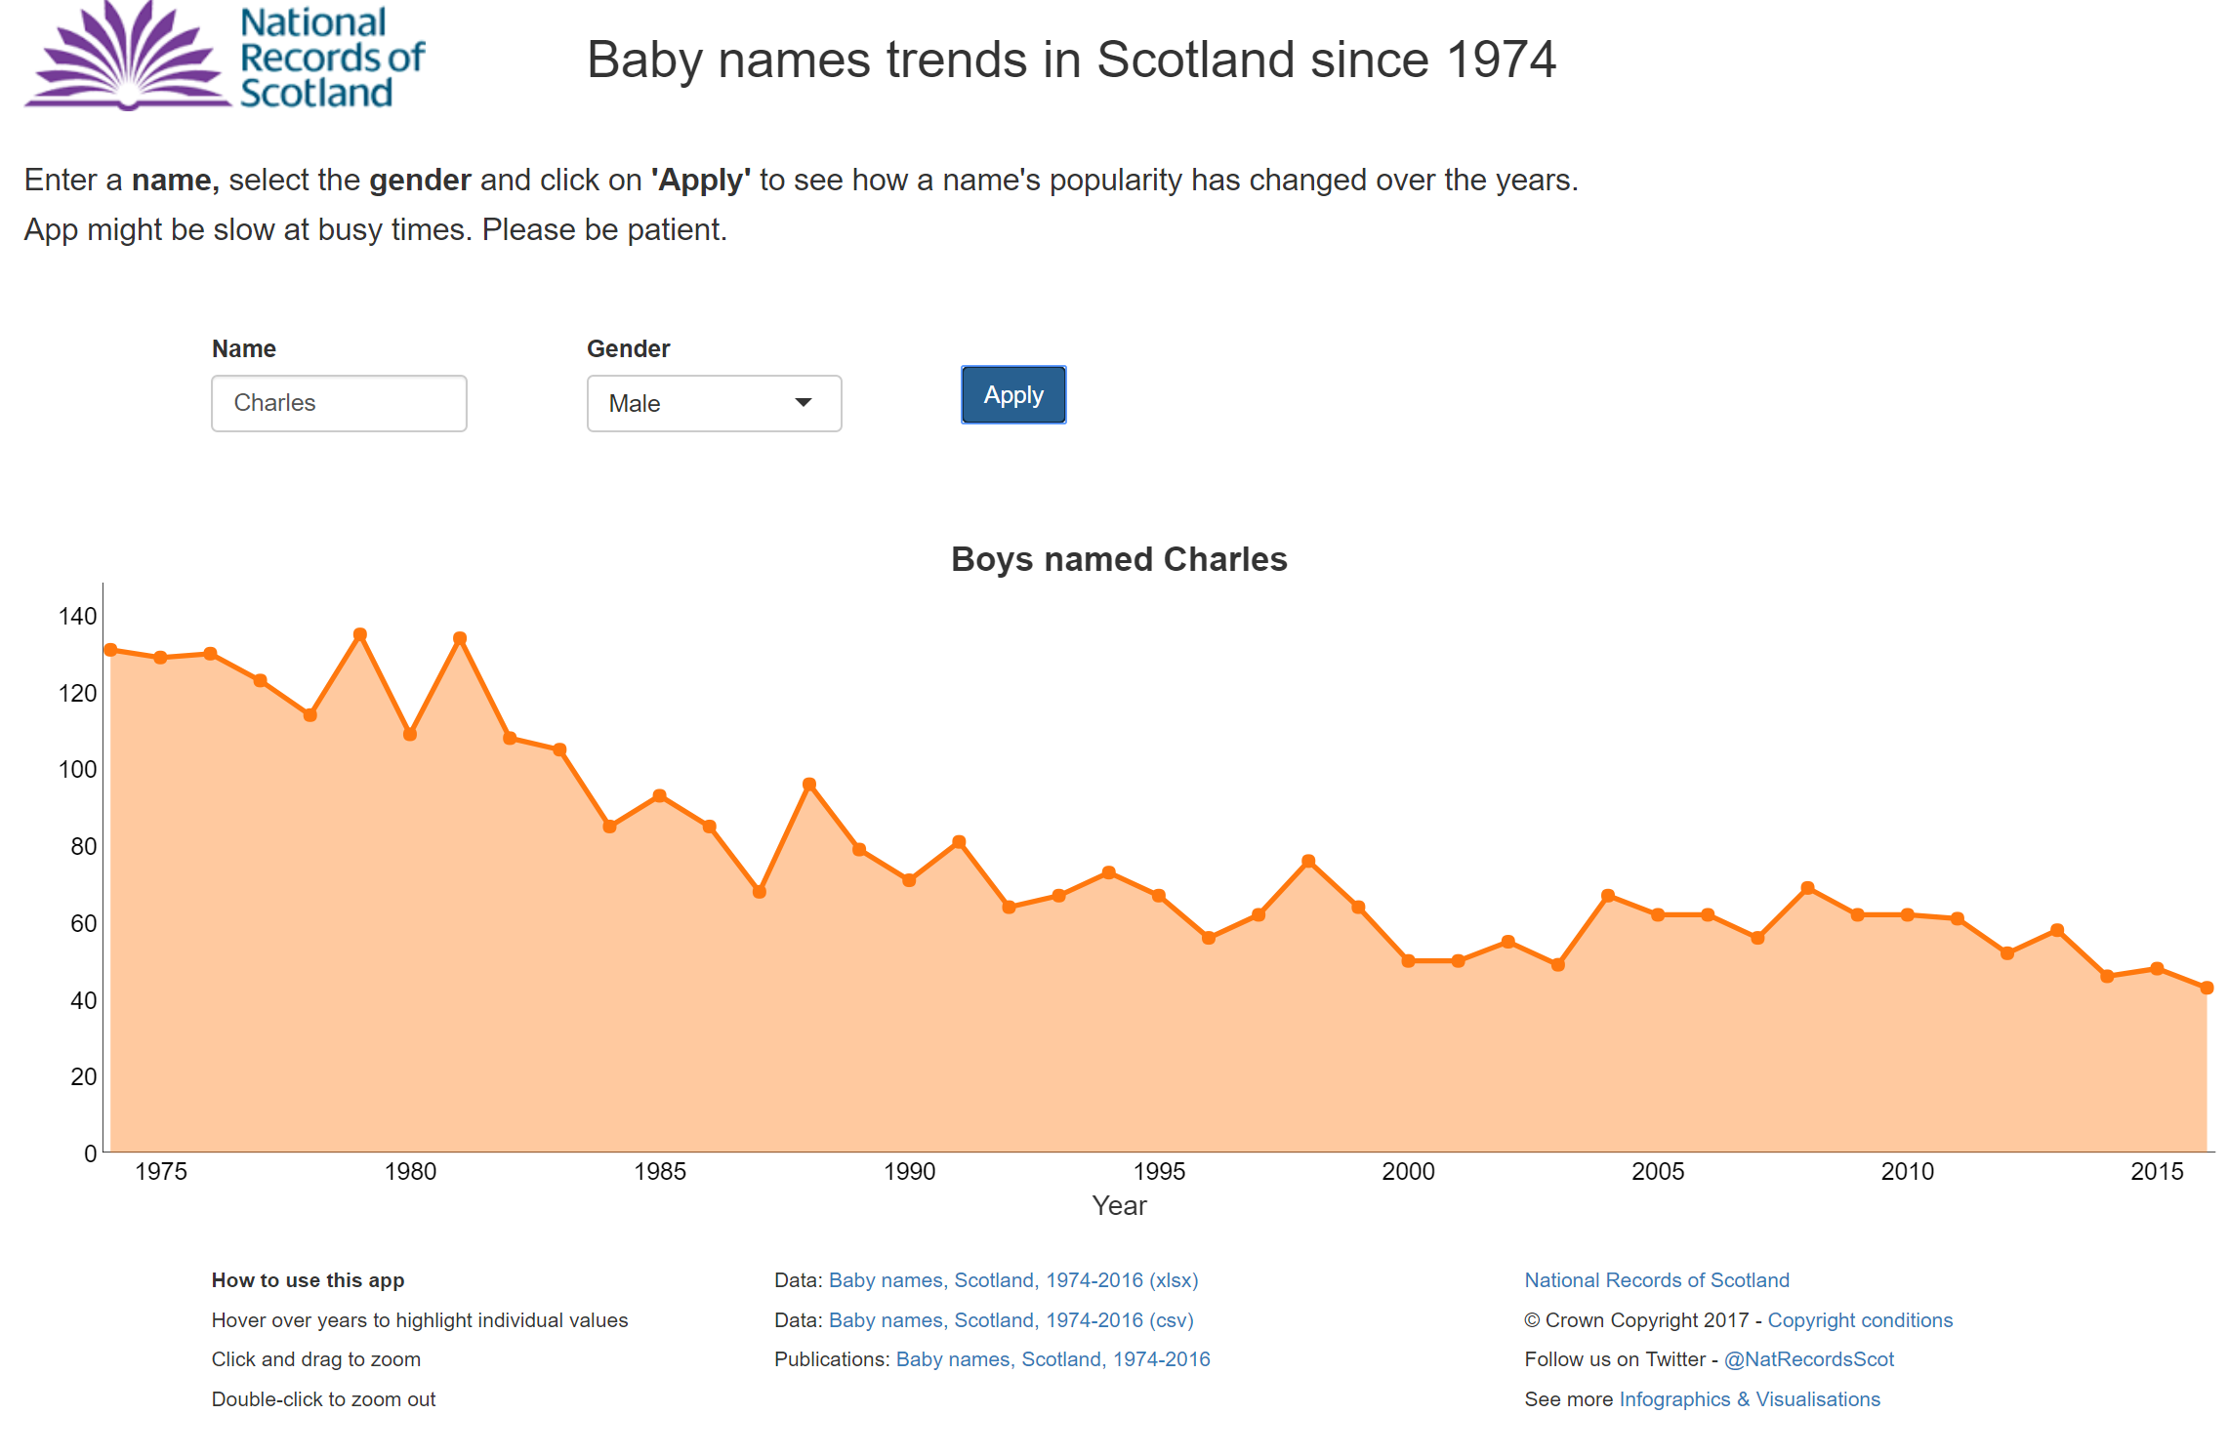
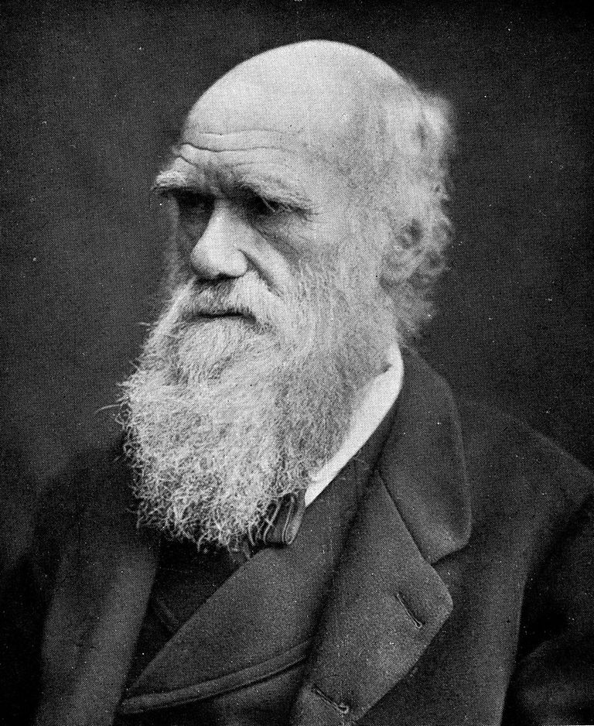
Interactive applications (shiny)
https://scotland.shinyapps.io/babynames/

Slide 7
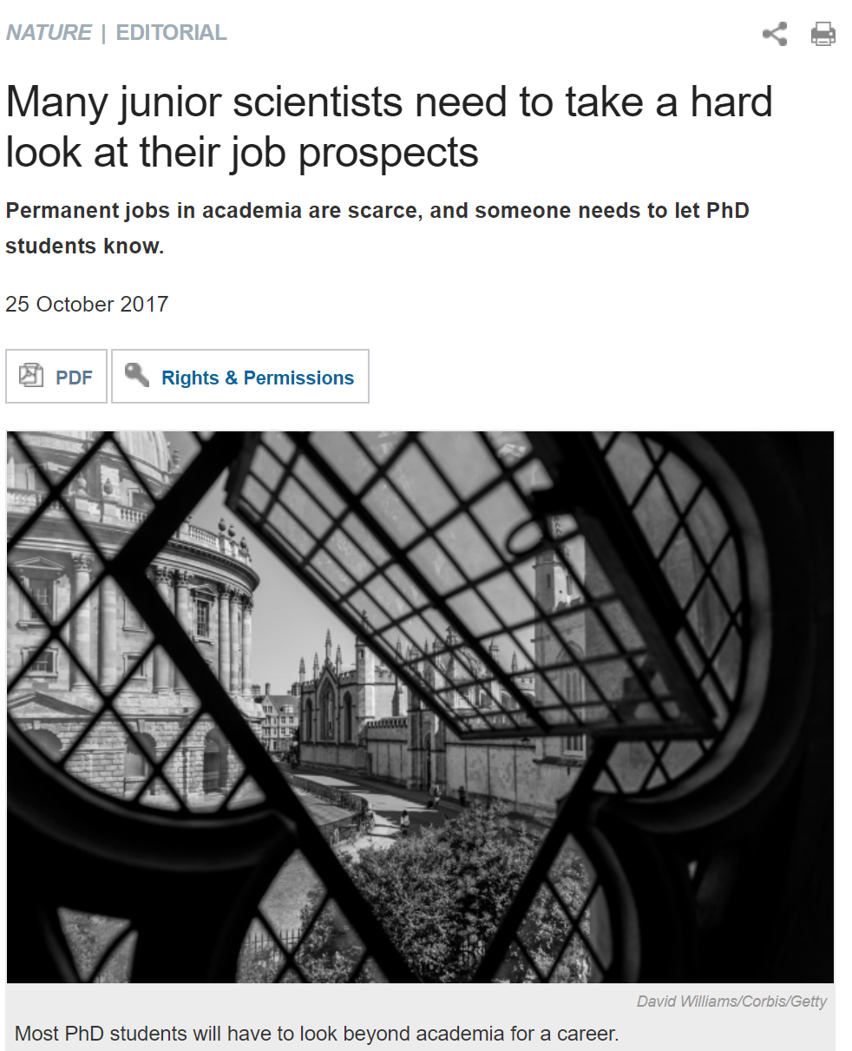
Programmers are in demand.
Massively transferable skill!
Facebook, Google, Twitter, Uber, AirBnB.
Private research companies.
R jobs in Edinburgh at the Scottish Government, RBS, Tesco Bank, Rockstar North, University of Edinburgh, Data Lab, Energy Companies.
Easy path to Python and other languages.

Slide 8
facilitates reproducible research.
“Reproducibility is the ability of an entire experiment or study to be reproduced, either by the researcher or by someone else working independently, [and] is one of the main principles of the scientific method.‘’
-Wikipedia

Slide 9
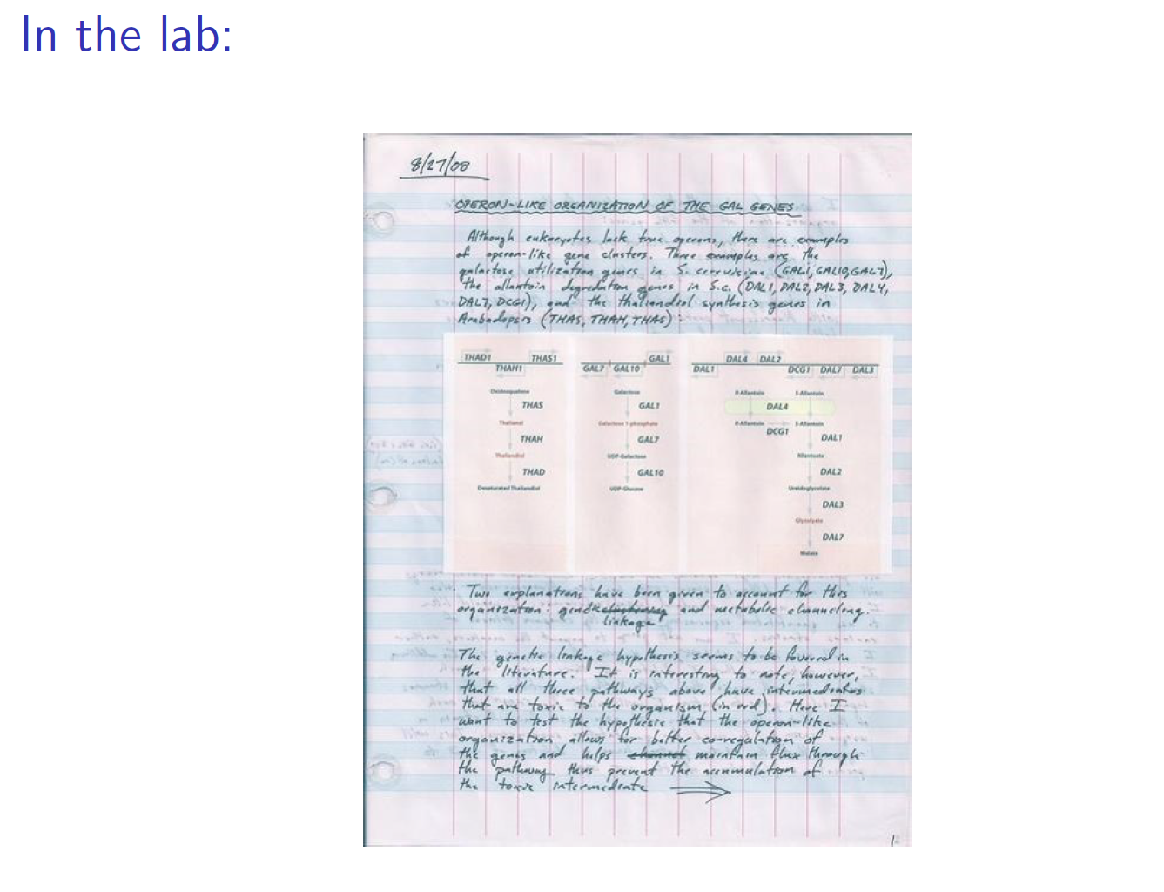

Slide 10
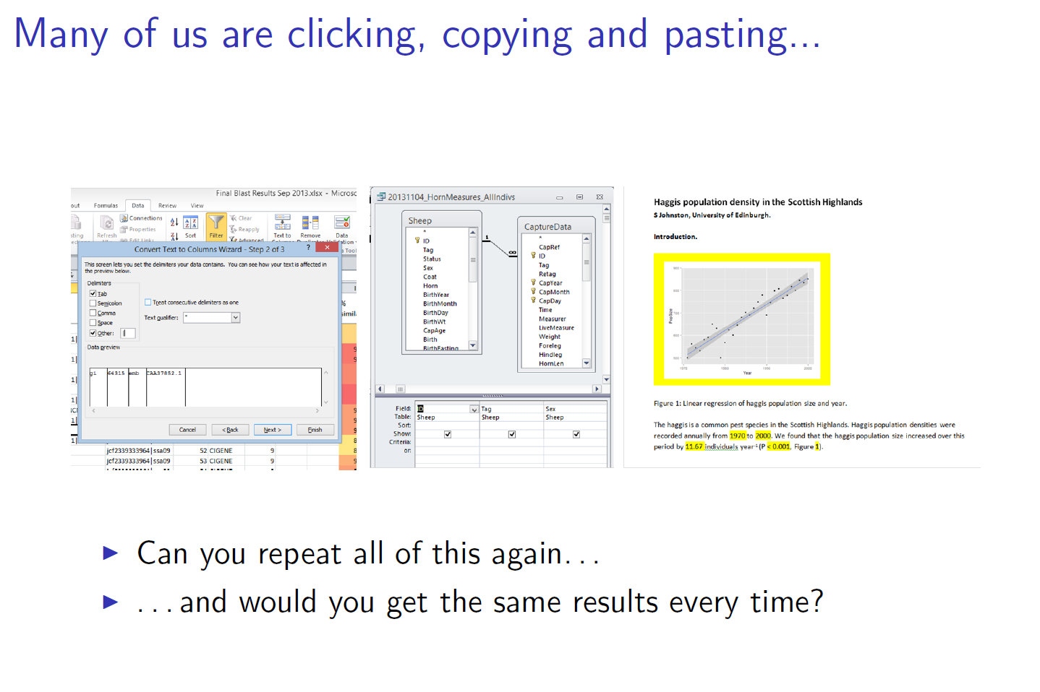

Slide 11
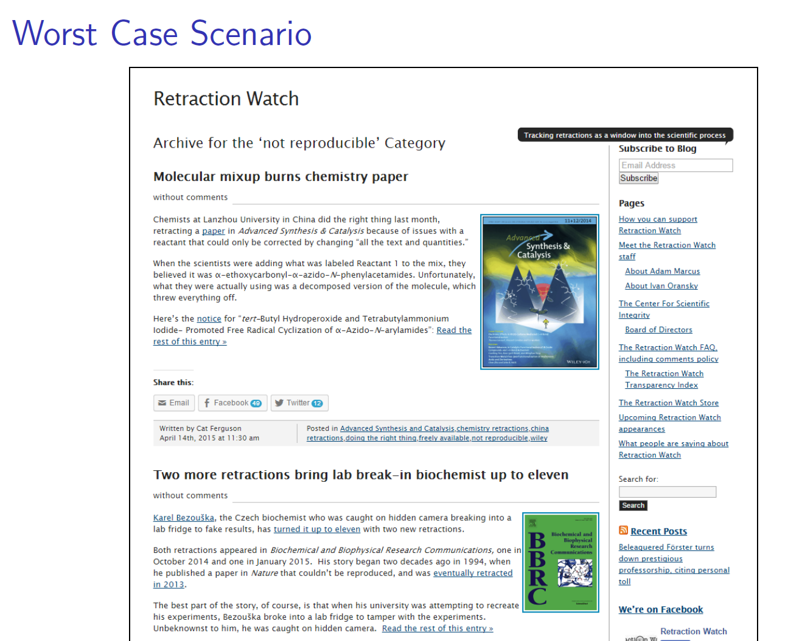

Slide 12
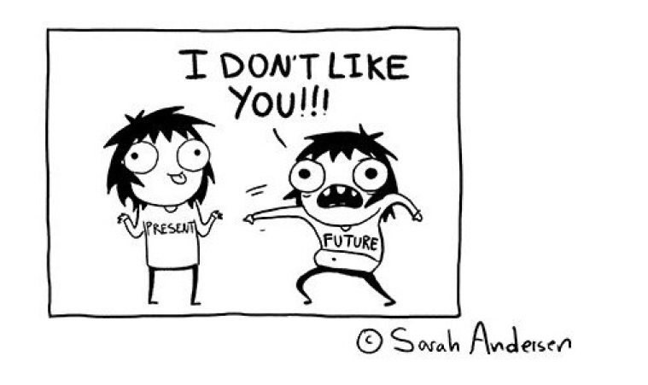
Scenarios that benefit from reproducibility
The first researcher who will need to reproduce results is likely to be YOU.
New data becomes available.
You return to a project after a period of time.
You give the project to a new student/collaborator.
A reviewer wants you to change a model parameter.
When you find an error, but not sure where you went wrong.

Slide 13
Overview
Getting Started: R and the Rstudio Environment.
Loading data into R.
Data Management in R with dplyr.
Data visualisation with ggplot2.

Slide 14
